Slide 1
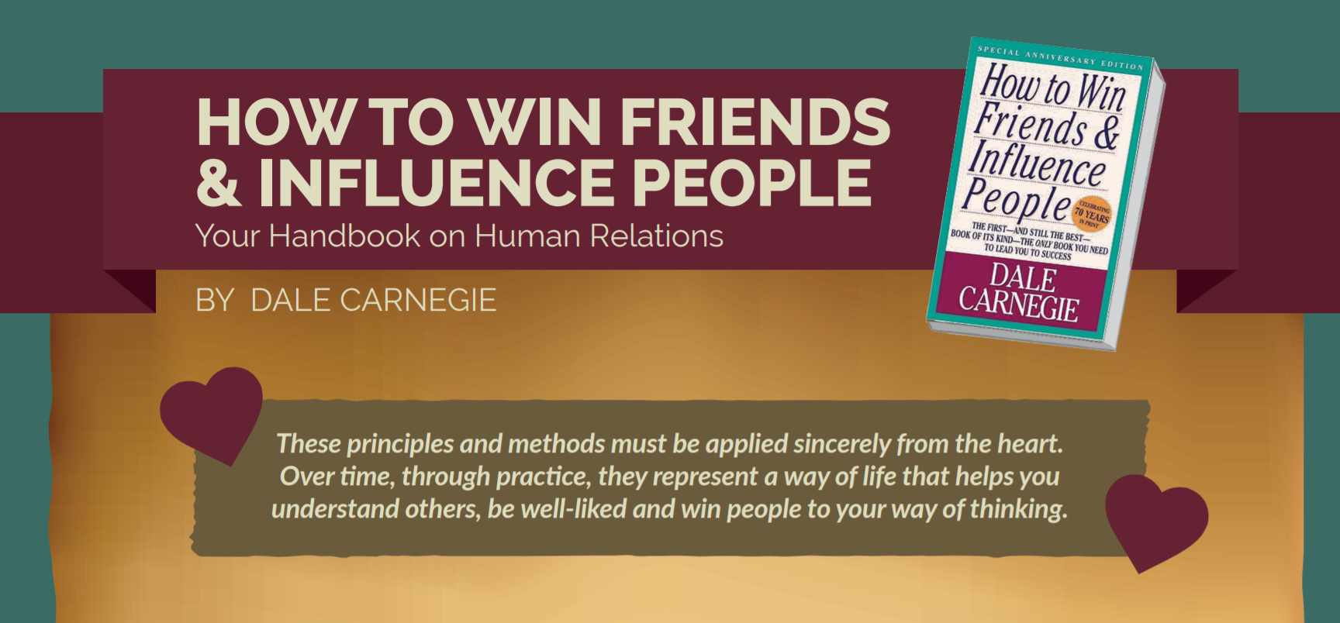

Slide 2

SUMMARY

Slide 3
TOPICS
Part 1: Fundamental Techniques in Handling People
3 Principles covered
Part 2: Six Ways to Make People Like You
6 Principles covered
Part 3: How to Win People to your Way of Thinking
12 Principles covered
Part 4: Be a Leader: How to change People Without Giving Offence or Arousing Resentment
9 Principles covered

Slide 4
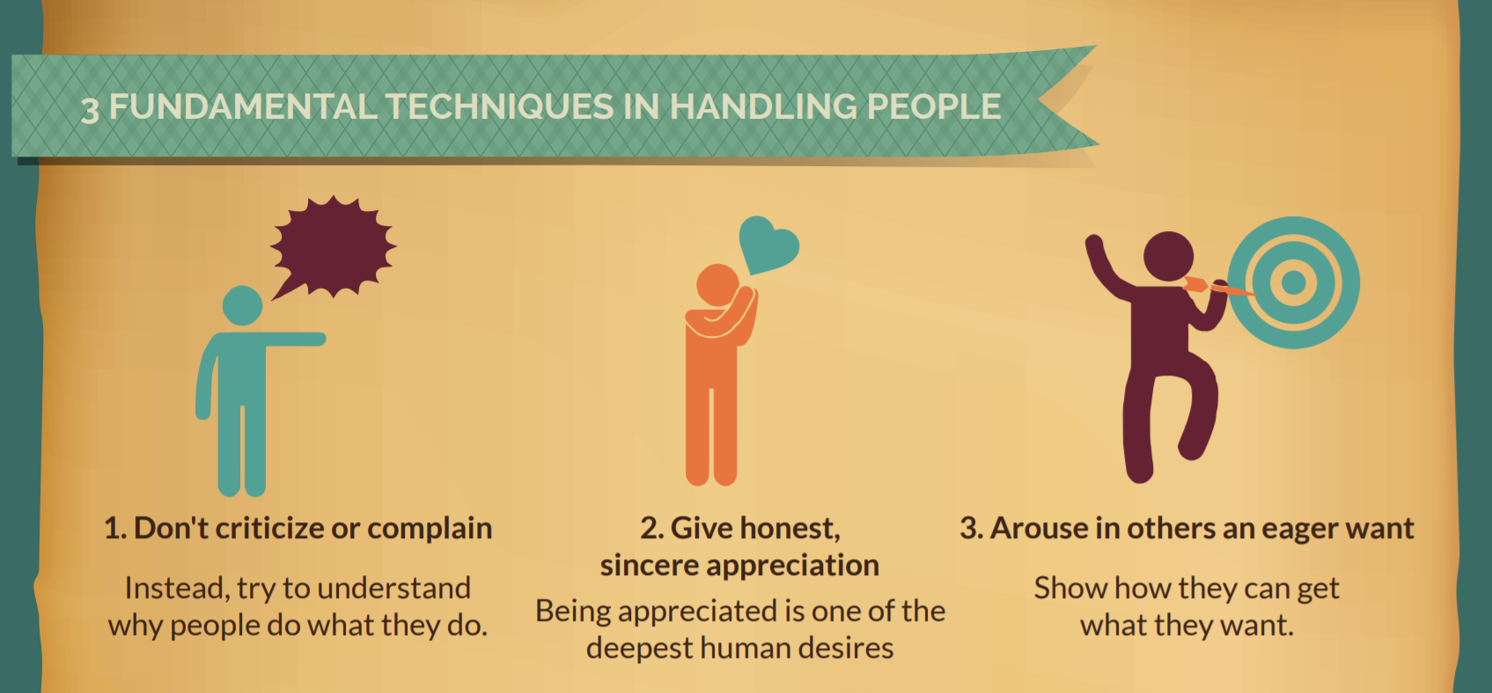

Slide 5
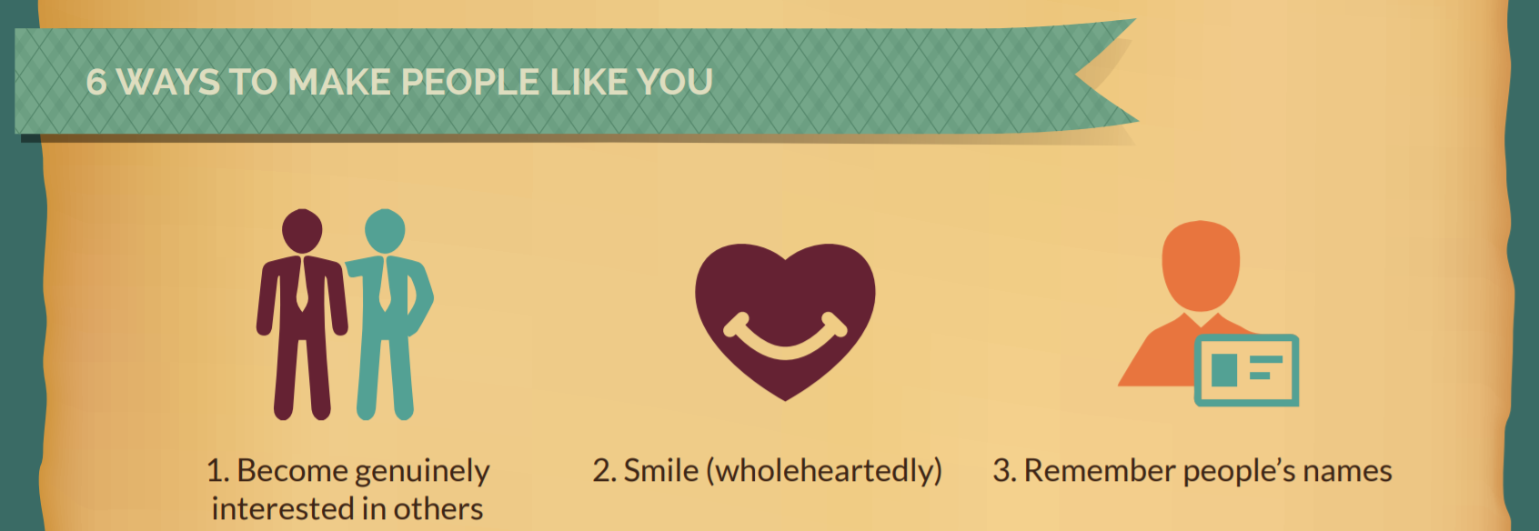

Slide 6

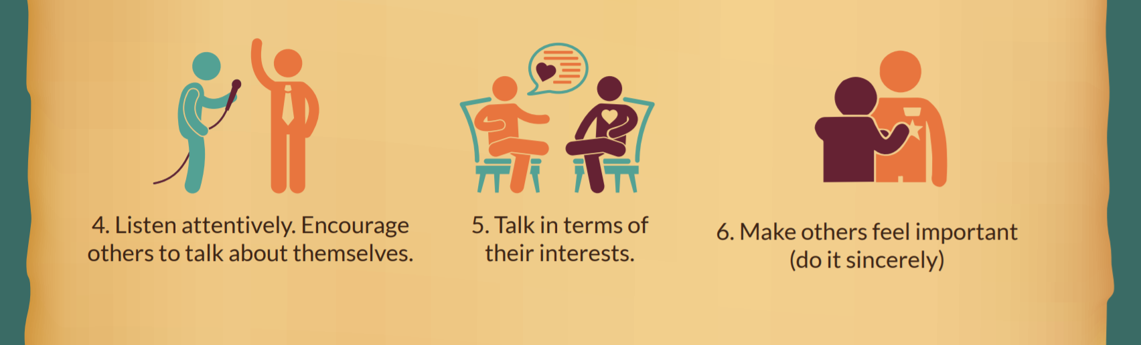

Slide 7
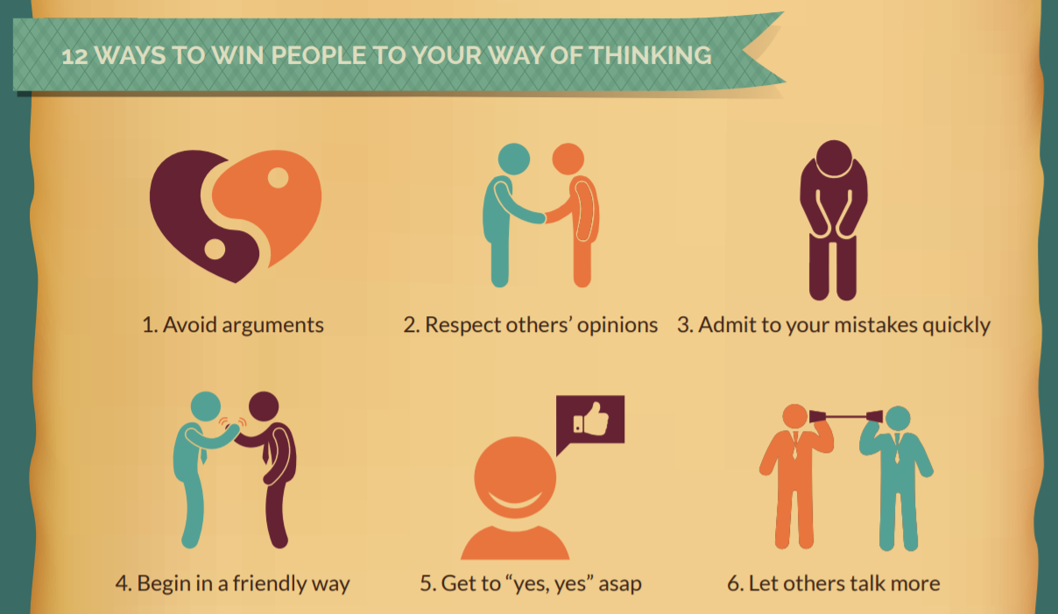

Slide 8
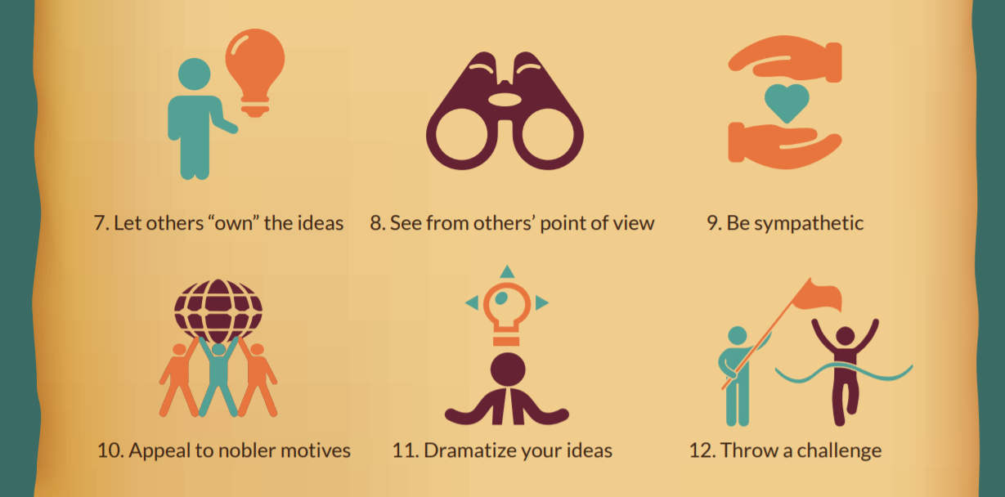

Slide 9
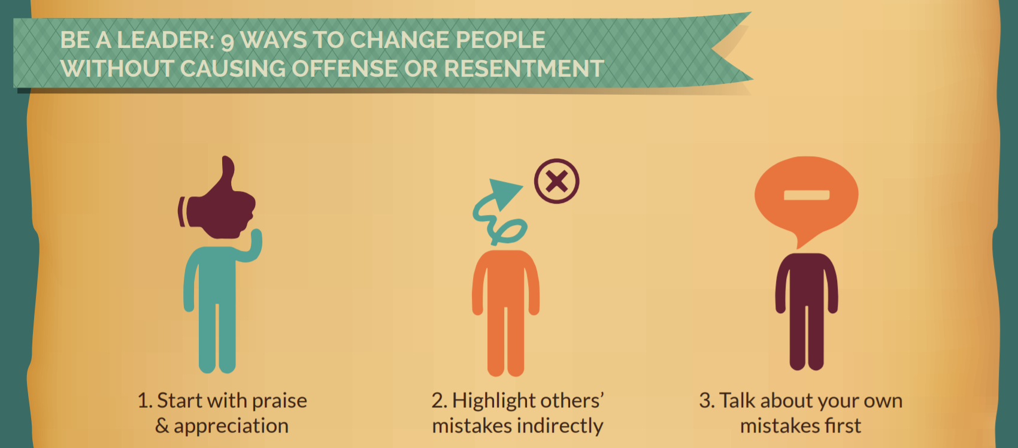

Slide 10



Slide 11
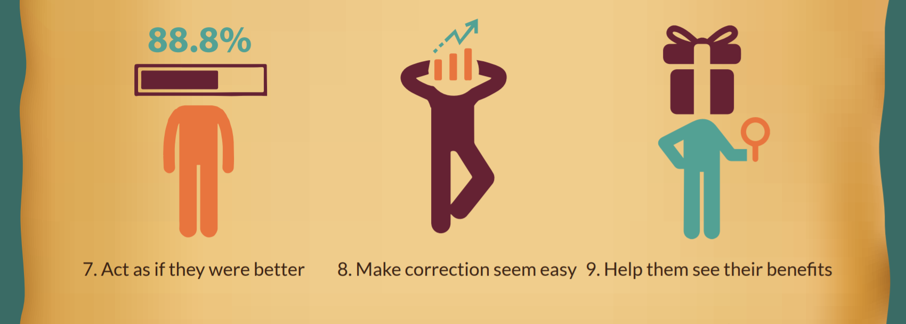

Slide 12

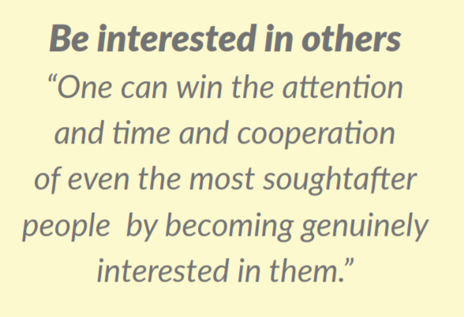
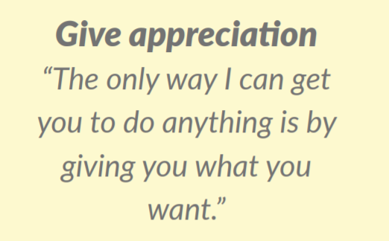
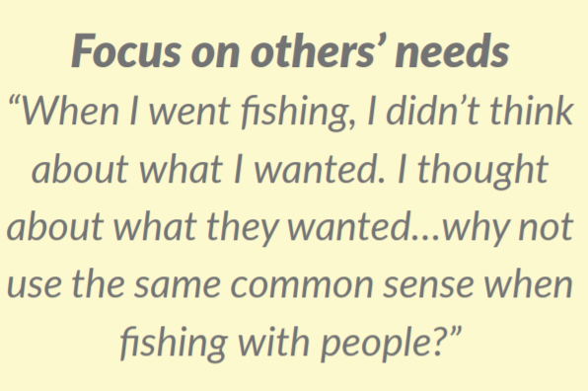

Slide 13
Thanks !

